Slide 1
Computer Organization and Architecture Exp 5 Sequential System

Slide 2
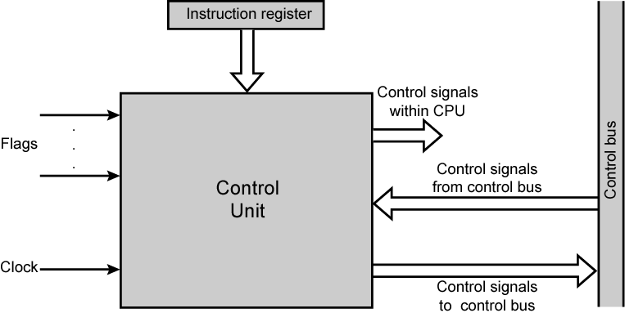
Model of Control Unit (Inputs and Outputs)
opcode
move data between registers

Slide 3
Control Signals - Inputs
Clock: how the control unit keeps time-by sequential system
One micro-instruction (or set of parallel micro-instructions) per clock cycle
Instruction register
Op-code for current instruction, determines which micro-instructions are performed
Flags
State of CPU: busy, idle
Results of previous ALU operations
Control signal from control bus
Interrupts and acknowledgements
Notes:
State of CPU: busy, idel

Slide 4
Preface
Experiment Purpose
(1) Understand the concept of “state machine”, master how to describe the sequential system based on the idea of “state machine”.
(2) Know the organization structure and design method of sequential system
Experiment content
Design a sequential system based on the theory of “state machine”. Make the traffic light on following this rule:“green->yellow->red->green…”. The lightening duration time can be independently set by dial switch. Green and ren lights are in constinuous light mode, while yellow lights are in flicker mode.

Slide 5
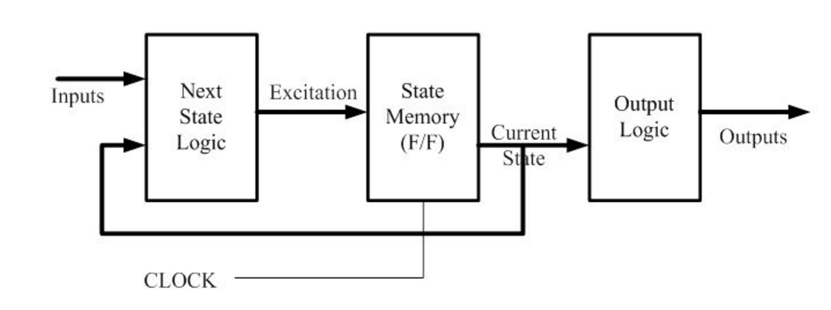
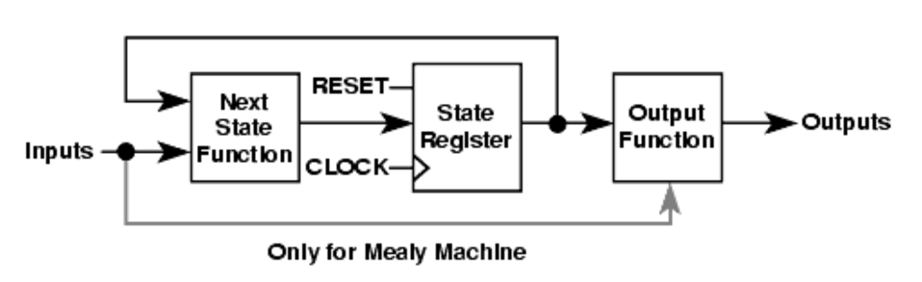
Moore Machine & Mealy Machine
Moore Machine
Moore machine’s output only depends on the present status and have no relation with the inputs, while Mealy machine depends on both of them.

Slide 6
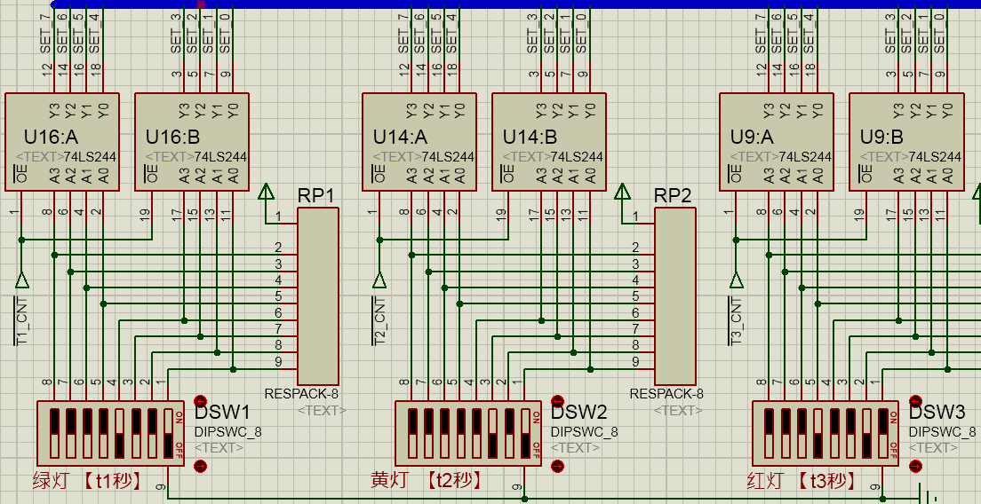
green
yellow
red
This partial diagram is to set the duration time of light.
Tx_CNT automatically chooses the proper data register

Slide 7
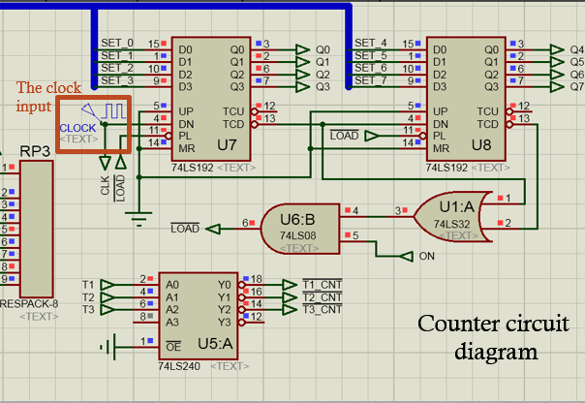
MR | #PL | UP | DN | Function | Q₀Q₁Q₂Q₃
1 | × | × | × | Clear | 0 0 0 0
0 | 0 | ↑ | × | Load | Q₀Q₁Q₂Q₃=D₀D₁D₂D₃
1 | × | 0/1/↓ | 0/1/↓ | Sustain | Q₀Q₁Q₂Q₃
l | l | ↑ | 0/1 | Counting CW | {Q₀ Q₁ Q₂ Q₃} status+1
0 | 1 | 0/1 | ↑ | Counting CCW | {Q₀ Q₁ Q₂ Q₃} status-1
74LS192
Logic
function
table
The function of this partial diagram is to circulate the statuses and send the present status into the sequential system.
Lights selector

Slide 8
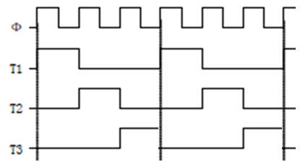
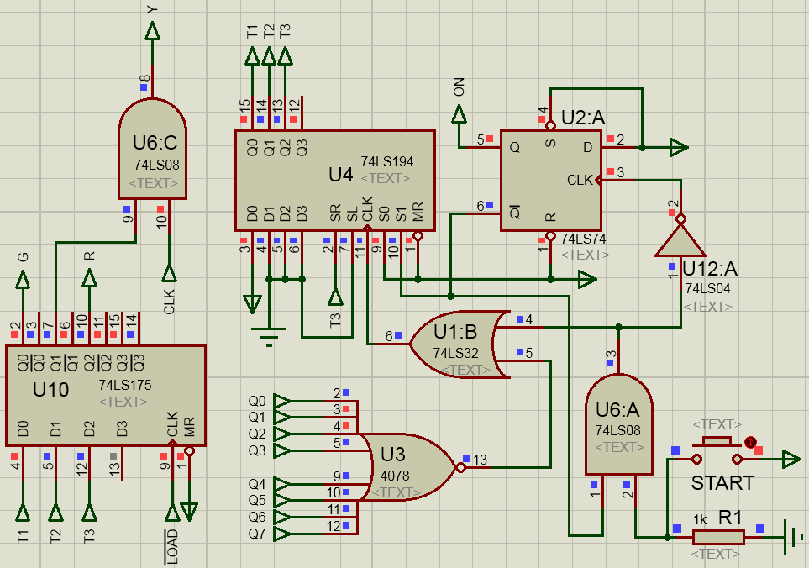
Shift register 74LS194
sequence diagram
The key point of designing sequential system is to initialize the shift register: Before CLK enables it, 74LS194 must get initial status such as the outputs will be {T1,T2,T3}={1,0,0}, then switch to rotating right shift mode.
flashing
yellow
light
Sequential system diagram
Press here!

Slide 9
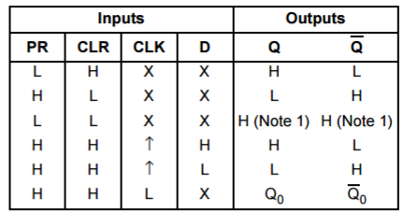
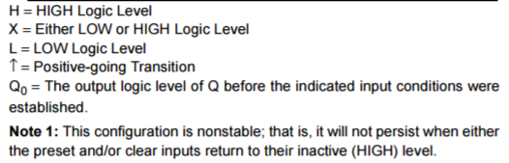
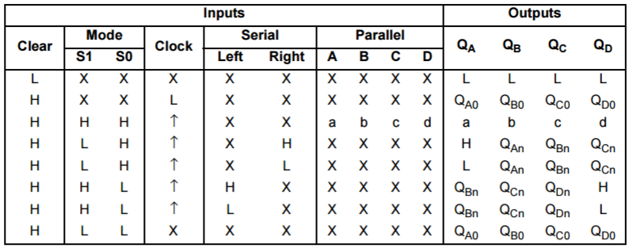
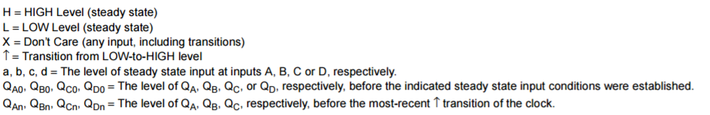
74LS74 – Flip-flop
74LS194 – Bi-directional Shift Register

Slide 10
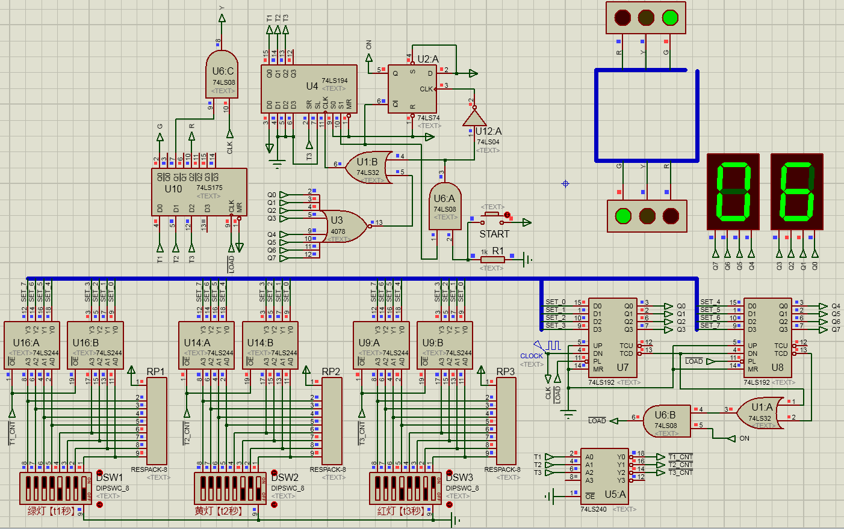

Slide 11
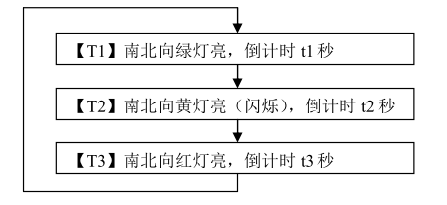
Experiment Steps
Start simulation, manually press “Start” button, make the traffic lights run as the workflow showing below.
When running, manipulate the DSWx switches to set the new initial values. Observe if the traffic lights are interfered? Answer when the change will take effect.
[T1] Green lights on, count down t1 seconds
[T2] Yellow lights on(flash), count down t2 seconds
[T3] Red lights on, count down t3 seconds

Slide 12
Bonus Qustion
If I want the red light to be on when pressing the start button, How to modify this circuit?

